Slide 1
Week 13
Heaps

Slide 2
Nearing the finish line…
Last week's lab:
Removing a node from a BST
Due before start of Thanksgiving Break (so, end of Tuesday)
Next online quiz:
Due next Monday
Project 7:
LeetCode, was due today. But it's OK if you are late on this assignment
Project 8:
Speedy Lookups
Due the last day of class
This is a 2-week assignment. You have 3 weeks to complete it.

Slide 3
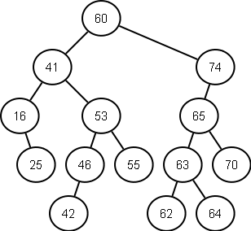
What is the inorder predecessor of 41?
16
25
42
53
55

Slide 4
What is the average time complexity of finding the max value in a well balanced binary search tree?
O(n)
O(log n)
O(n log n)
O(n^2)
O(2^n)

Slide 5
Trees….big ideas
Parent-child relationship
General tree: parent can have any number of children
Binary tree: parent can have 0, 1, or 2 children. Duplicates allowed.
Binary search tree: No duplicates. And at each node…
All nodes in left subtree are smaller
All nodes in right subtree are larger
Well balanced: add, remove, find are O(log n) worst case
Badly balanced: add, remove, find are O(n) worst case
Fairly easy to implement the code to add a node (and find a node)
Trickier to implement node removal (but it’s still O(log n) for a balanced tree)

Slide 6
Heaps:
4
7
10
Complete binary trees
All levels (except maybe the last) are full
Last is filled left to right
Two common types: minheap and maxheap
Minheap: at each node, all children >= parent (so, “min” is at the root)
Maxheap: at each node, all children <= parent (so, “max” is at the root)
Useful way to implement “priority queue” ADT, because the highest priority item is always at the top
Offers O(log n) adding and removing
Gives us a new way to sort: heapsort
O(n log n)
Iterative (loops, no recursion)
34
20
19
26
45
38
24
56
20

Slide 7
Heap implementation:
Usually with arrays, rather than linked nodes
Array filled in using level-order traversal
Typically we won’t use the first spot in the array

Slide 8
Example: minheap
4
7
10
34
20
19
26
45
38
24
56
20
0 | 1 | 2 | 3 | 4 | 5 | 6 | 7 | 8 | 9 | 10 | 11 | 12 | 13 | 14 | 15 | 16 | 17 | 18 | 19
 | 4 | 7 | 10 | 34 | 20 | 19 | 26 | 45 | 38 | 24 | 56 | 20

Slide 9
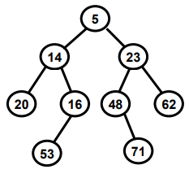
Is this a minheap?
yes
no

Slide 10
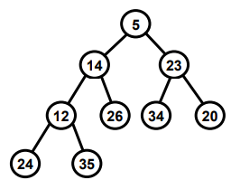
Is this a minheap?
yes
no

Slide 11
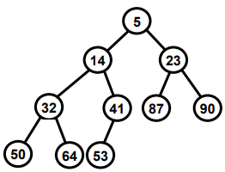
Is this a minheap?
yes
no

Slide 12
Is this a minheap?
yes
no
4
4
4
34
20
19
26
45
38
24
56
20

Slide 13
Array indexes for a minheap:
4
7
10
34
20
19
26
45
38
24
56
20
0 | 1 | 2 | 3 | 4 | 5 | 6 | 7 | 8 | 9 | 10 | 11 | 12 | 13 | 14 | 15 | 16 | 17 | 18 | 19
 | 4 | 7 | 10 | 34 | 20 | 19 | 26 | 45 | 38 | 24 | 56 | 20

Slide 14



4
7
10
34
20
19
26
45
38
24
56
20
0 | 1 | 2 | 3 | 4 | 5 | 6 | 7 | 8 | 9 | 10 | 11 | 12 | 13 | 14 | 15 | 16 | 17 | 18 | 19
 | 4 | 7 | 10 | 34 | 20 | 19 | 26 | 45 | 38 | 24 | 56 | 20

Slide 15
Is this a minheap?
0 | 1 | 2 | 3 | 4 | 5 | 6 | 7 | 8 | 9 | 10 | 11 | 12 | 13 | 14 | 15 | 16 | 17 | 18 | 19
 | 5 | 14 | 12 | 13 | 19 | 79 | 80 | 16
yes
no
The children of node 2 are nodes 4 and 5.
So nodes 4 and 5 must both be >= 14.

Slide 16
In a minheap, what are the children of node #8?
Nodes #9 and #10
Nodes #15 and #16
Nodes #16 and #17
Nodes #64 and #65

Slide 17
In a minheap, what is the parent of node #23?
node #11
node #12
node #22
node #23

Slide 18
True or False: In a minheap, each subtree is a minheap
True
False

Slide 19
True or False: It is possible for a tree of height 2 to be both a minheap and a binary search tree
True
False

Slide 20
What about maxheaps?
Exact same idea, but the largest is at the top
Children <= parent
So, we will just look at minheaps today.

Slide 21
Adding and removing nodes in a heap
O(log n) operations
where n is the number of nodes
Sometimes referred to as O(h) operations
where h is the height of the tree

Slide 22
Adding:
Add the node in the next available empty node
Fix the heap

Slide 23
Example: add the value 9 to this minheap
4
7
10
34
20
19
26
45
38
24
56
20
0 | 1 | 2 | 3 | 4 | 5 | 6 | 7 | 8 | 9 | 10 | 11 | 12 | 13 | 14 | 15 | 16 | 17 | 18 | 19
 | 4 | 7 | 10 | 34 | 20 | 19 | 26 | 45 | 38 | 24 | 56 | 20

Slide 24
Adding 9: First put 9 in the last node
4
7
10
34
20
19
26
45
38
24
56
20
9
0 | 1 | 2 | 3 | 4 | 5 | 6 | 7 | 8 | 9 | 10 | 11 | 12 | 13 | 14 | 15 | 16 | 17 | 18 | 19
 | 4 | 7 | 10 | 34 | 20 | 19 | 26 | 45 | 38 | 24 | 56 | 20 | 9

Slide 25
Fixing the minheap:
If a child is smaller than its parent, swap.

Slide 26
Swap 9 upward, until it is >= its children…
4
7
10
34
20
9
26
45
38
24
56
20
19
0 | 1 | 2 | 3 | 4 | 5 | 6 | 7 | 8 | 9 | 10 | 11 | 12 | 13 | 14 | 15 | 16 | 17 | 18 | 19
 | 4 | 7 | 10 | 34 | 20 | 9 | 26 | 45 | 38 | 24 | 56 | 20 | 19

Slide 27
Swap 9 upward, until it is >= its children…
4
7
9
34
20
10
26
45
38
24
56
20
19
0 | 1 | 2 | 3 | 4 | 5 | 6 | 7 | 8 | 9 | 10 | 11 | 12 | 13 | 14 | 15 | 16 | 17 | 18 | 19
 | 4 | 7 | 9 | 34 | 20 | 10 | 26 | 45 | 38 | 24 | 56 | 20 | 19

Slide 28
In this case, 2 swaps and we have a minheap again
4
7
9
34
20
10
26
45
38
24
56
20
19
0 | 1 | 2 | 3 | 4 | 5 | 6 | 7 | 8 | 9 | 10 | 11 | 12 | 13 | 14 | 15 | 16 | 17 | 18 | 19
 | 4 | 7 | 9 | 34 | 20 | 10 | 26 | 45 | 38 | 24 | 56 | 20 | 19

Slide 29
Removing:
In a minheap, we only care about one kind of remove() method:
removeMin()
That is, we only care about removing the top element, which is always the smallest element in a minheap.
That's why minheaps (and maxheaps) are good for priority queues. The "highest priority" element is always at the top of the heap.

Slide 30
Removing the min from a minheap:
Grab the value
Take the value from the last leaf and move it to the top
Fix the heap
Swap downward until the heap is fixed
This means…
"If a parent is larger than one of its children, swap it with that child."
"If a parent is larger than both of its children, swap it with the smaller child."

Slide 31
What is heapsort?
make a minheap
repeatedly remove the top (smallest value)
do this until the heap is empty

